Slide 1
Applied Mathematics

Slide 2
Table of Contents
Vector Calculus
Gradient, divergence, and curl operators
Divergence, Green’s, and Stokes’ theorems
Linear Algebra
Finite-dimensional vector spaces and subspaces
Linear independence
Orthogonality of vectors and subspaces
Properties of the determinant
Eigenvalues and eigenvectors
Linear Ordinary Differential Equations
Initial-value problems
Two-point boundary-value problems
Homogeneous and nonhomogeneous solutions
Solution techniques
Laplace transforms
Solution of systems of ODE’s using matrix methods
Linear Partial Differential Equations
Classification of PDE’s
Separation of variables
Laplace transforms
Fourier transforms
Elementary Numerical Analysis
Root-finding techniques, e.g. bisection, Newton-Raphson, secant, and fixed-point
Curve fitting by the method of least squares
Functional approximation using Fourier series or polynomial series
Numerical integration, e.g., trapezoidal rule and Simpson’s rule
Integration of ODEs, e.g., Euler, Runge-Kutta, and predictor-corrector methods

Slide 3
Vector Calculus

Slide 4
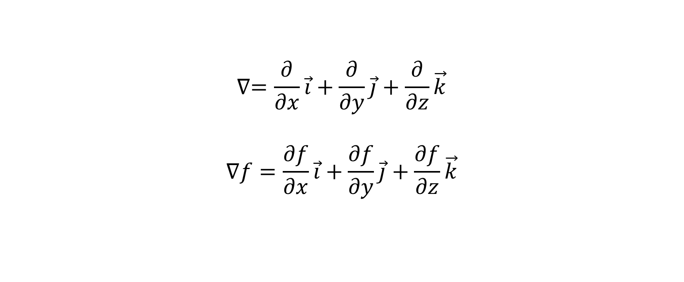
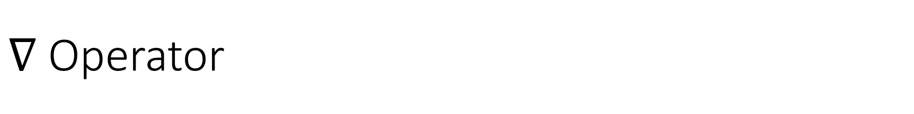
$∇$ Operator
$$∇=\frac{∂}{∂x}\vec{i}+\frac{∂}{∂y}\vec{j}+\frac{∂}{∂z}\vec{k}$$
$$∇f=\frac{∂f}{∂x}\vec{i}+\frac{∂f}{∂y}\vec{j}+\frac{∂f}{∂z}\vec{k}$$

Slide 5
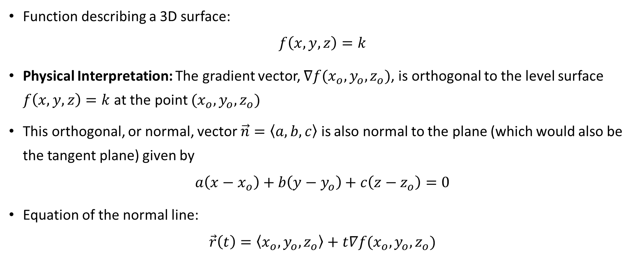
Gradient
Function describing a 3D surface:
$$f\left(x,y,z\right)=k$$
Physical Interpretation: The gradient vector, $∇f(x_{o},y_{o},z_{o})$, is orthogonal to the level surface $f\left(x,y,z\right)=k$ at the point $(x_{o},y_{o},z_{o})$
This orthogonal, or normal, vector $\vec{n}=\left\langle a,b,c\right\rangle$ is also normal to the plane (which would also be the tangent plane) given by
$$a\left(x−x_{o}\right)+b\left(y−y_{o}\right)+c\left(z−z_{o}\right)=0$$
Equation of the normal line:
$$\vec{r}\left(t\right)=\left\langle x_{o},y_{o},z_{o}\right\rangle +t∇f(x_{o},y_{o},z_{o})$$

Slide 6
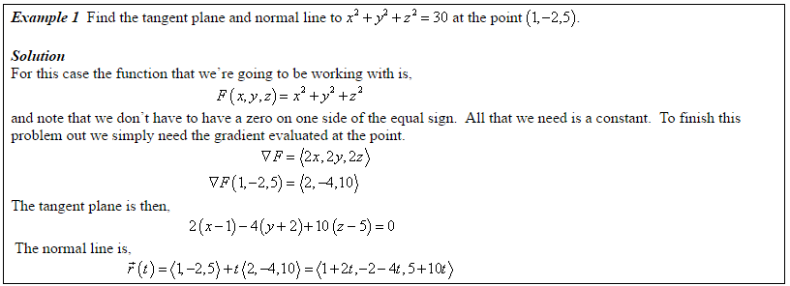
Example

Slide 7
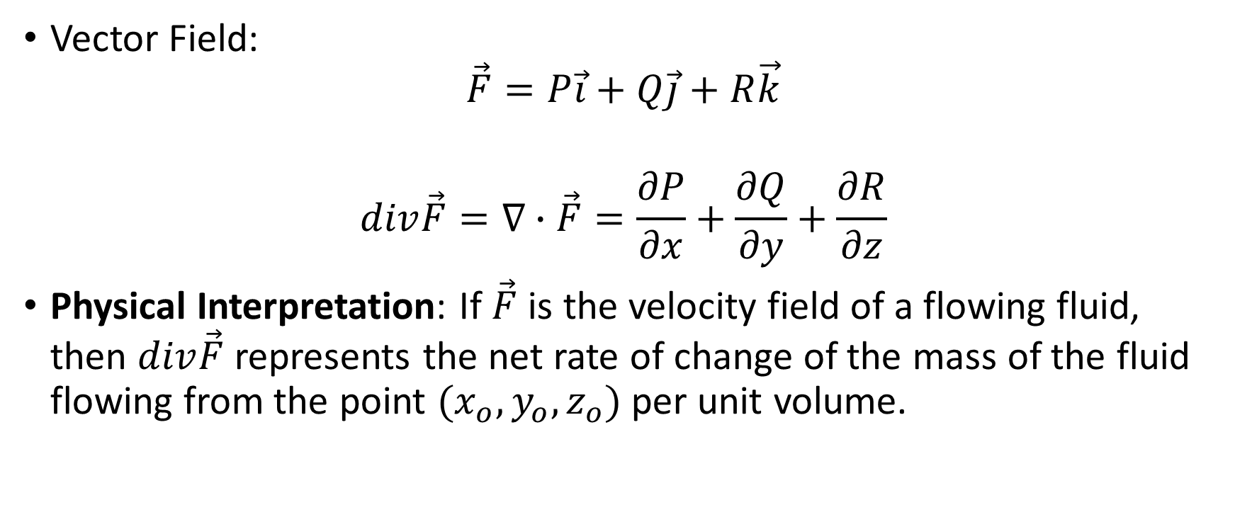
Divergence
Vector Field:
$$\vec{F}=P\vec{i}+Q\vec{j}+R\vec{k}$$
$$div\vec{F}=∇∙\vec{F}=\frac{∂P}{∂x}+\frac{∂Q}{∂y}+\frac{∂R}{∂z}$$
Physical Interpretation: If $\vec{F}$ is the velocity field of a flowing fluid, then $div\vec{F}$ represents the net rate of change of the mass of the fluid flowing from the point $(x_{o},y_{o},z_{o})$ per unit volume.

Slide 8
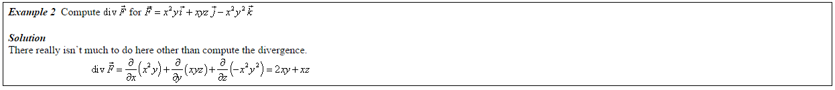
Example

Slide 9
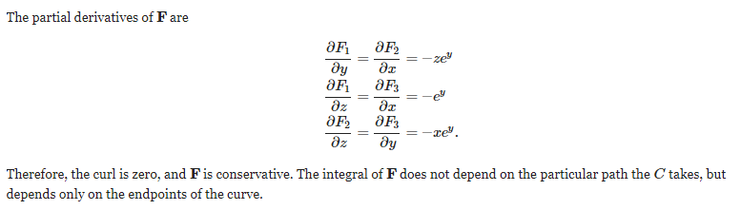
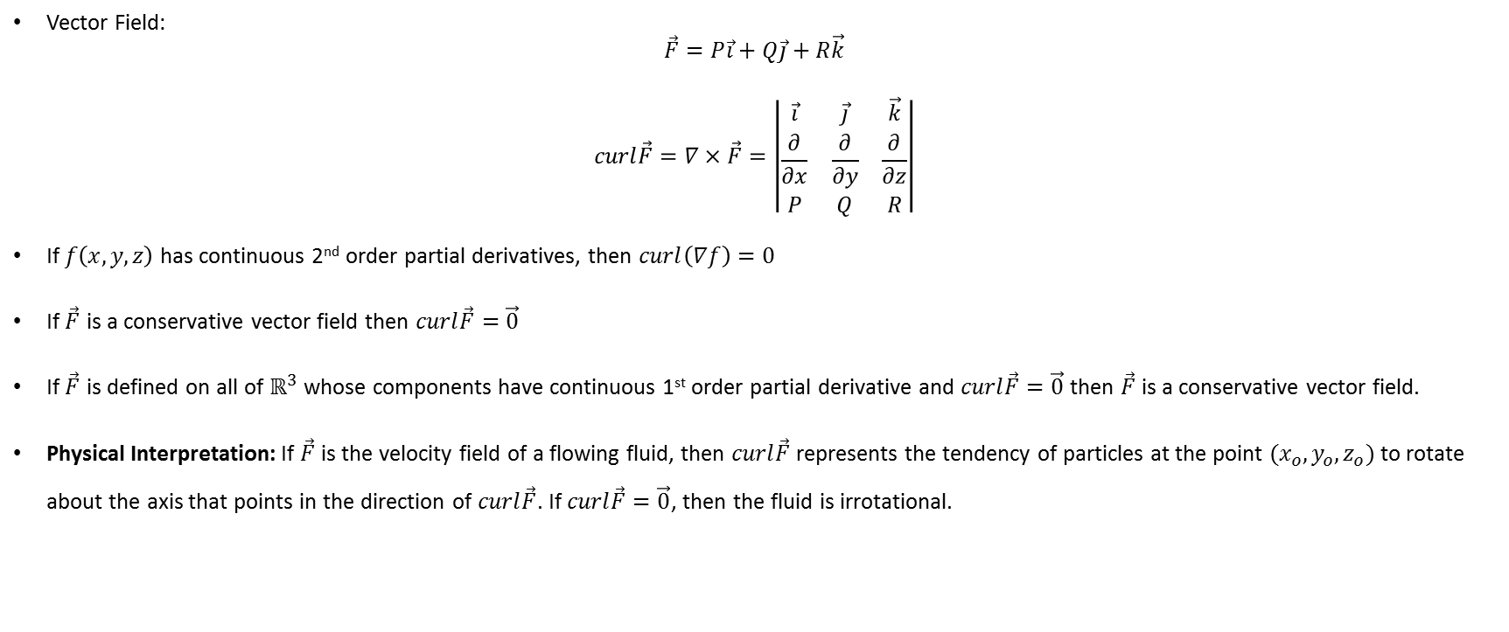
Curl
Vector Field:
$$\vec{F}=P\vec{i}+Q\vec{j}+R\vec{k}$$
$$curl\vec{F}=∇×\vec{F}=\left|\begin{matrix}\vec{i} & \vec{j} & \vec{k} \\ \frac{∂}{∂x} & \frac{∂}{∂y} & \frac{∂}{∂z} \\ P & Q & R\end{matrix}\right|$$
If $f\left(x,y,z\right)$ has continuous 2nd order partial derivatives, then $curl\left(∇f\right)=0$
If $\vec{F}$ is a conservative vector field then $curl\vec{F}=\vec{0}$
If $\vec{F}$ is defined on all of $ℝ^{3}$ whose components have continuous 1st order partial derivative and $curl\vec{F}=\vec{0}$ then $\vec{F}$ is a conservative vector field.
Physical Interpretation: If $\vec{F}$ is the velocity field of a flowing fluid, then $curl\vec{F}$ represents the tendency of particles at the point $(x_{o},y_{o},z_{o})$ to rotate about the axis that points in the direction of $curl\vec{F}$. If $curl\vec{F}=\vec{0}$, then the fluid is irrotational.
Side note:

Slide 10
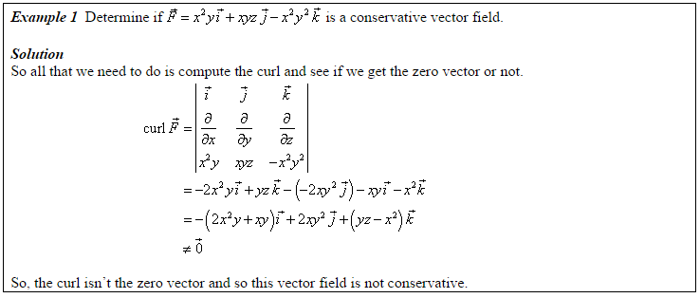
Example

Slide 11
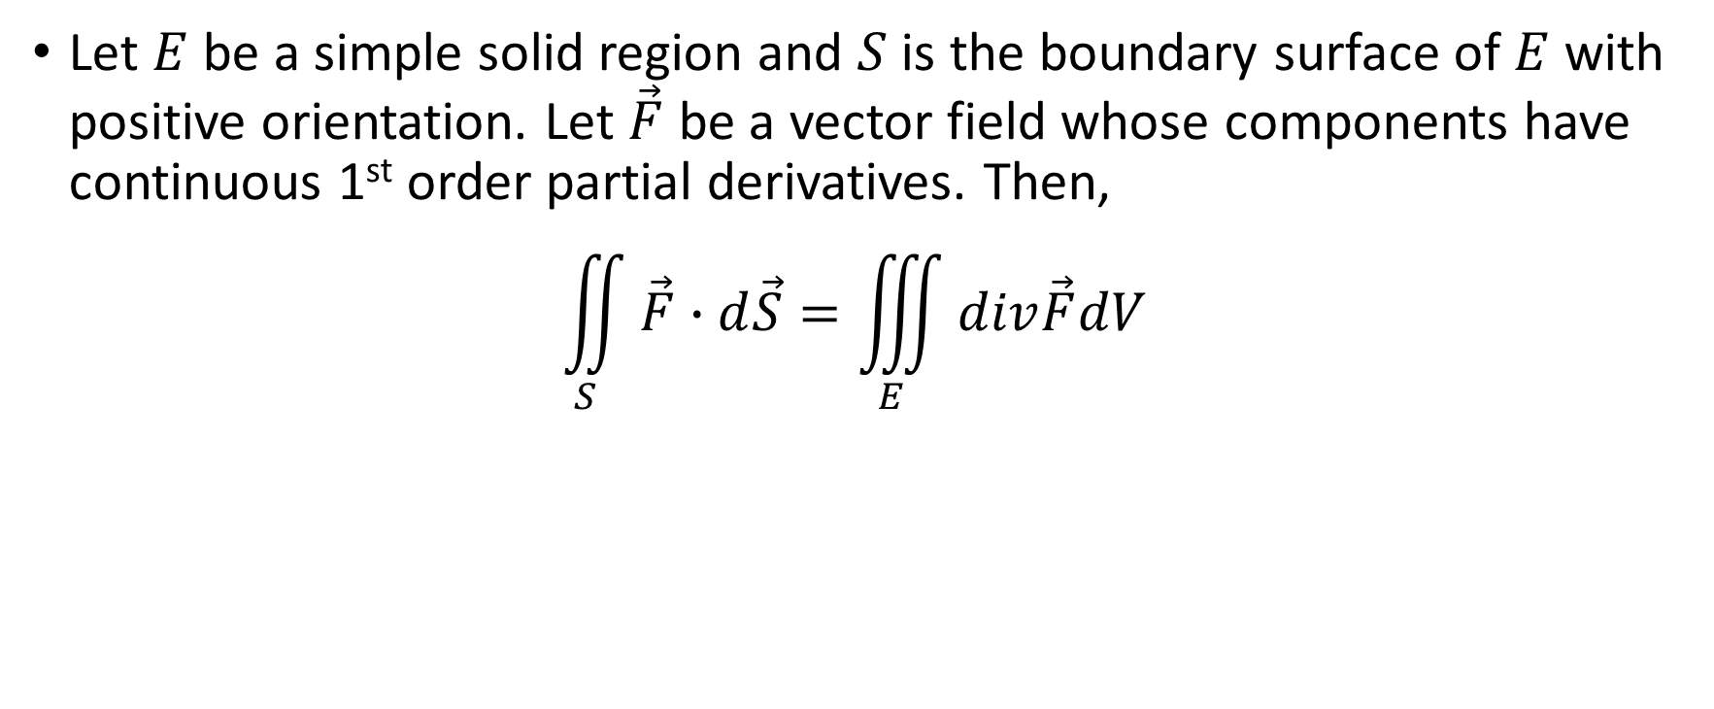
Divergence Theorem
Let $E$ be a simple solid region and $S$ is the boundary surface of $E$ with positive orientation. Let $\vec{F}$ be a vector field whose components have continuous 1st order partial derivatives. Then,
$$\iint_{S}{\vec{F}∙d\vec{S}=\iiint_{E}{div\vec{F}dV}}$$

Slide 12
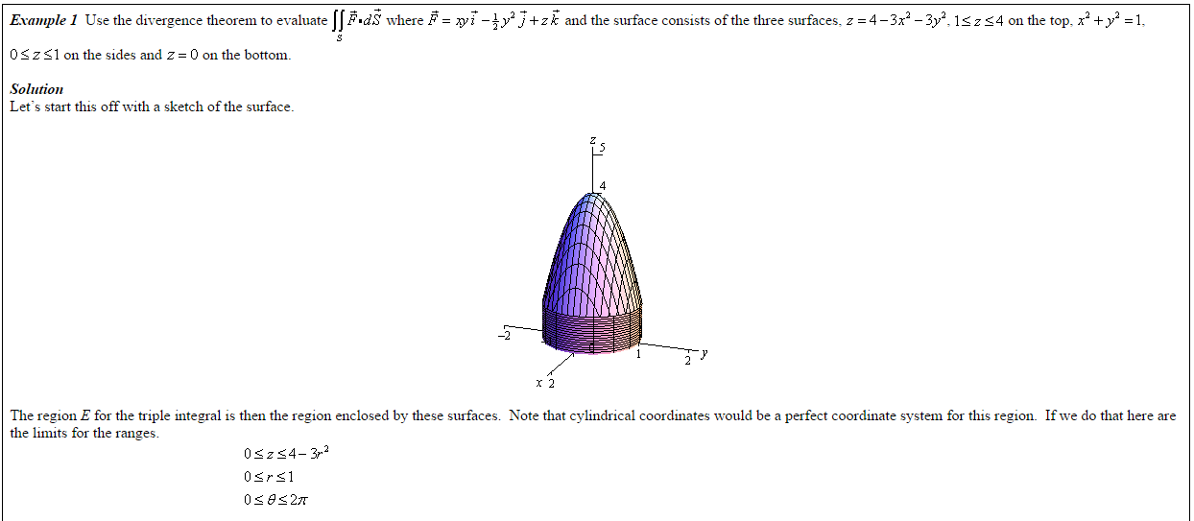
Example

Slide 13
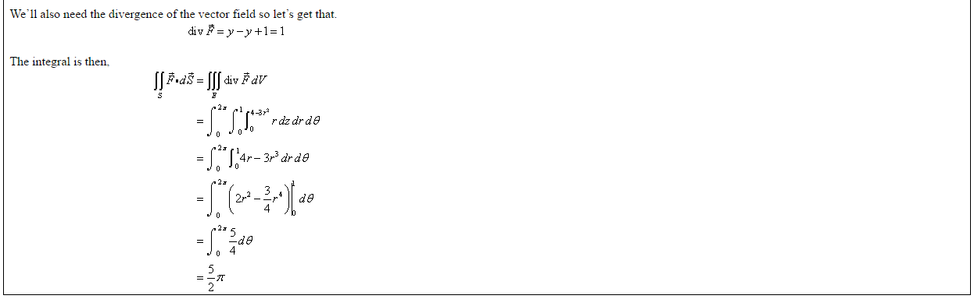
Example

Slide 14
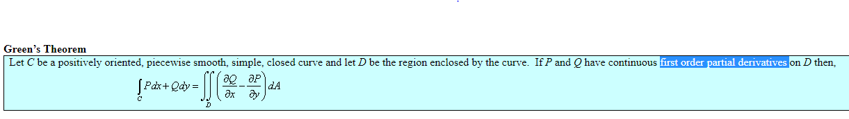
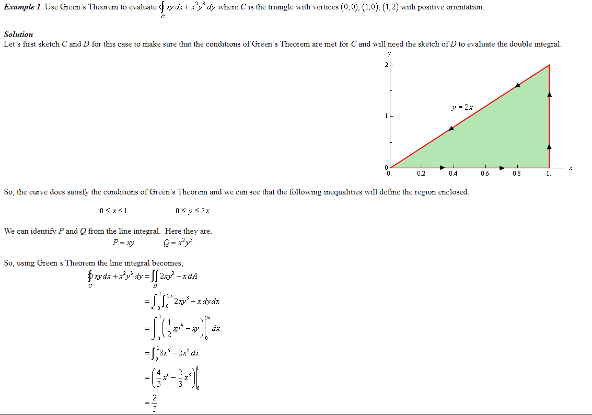

Slide 15
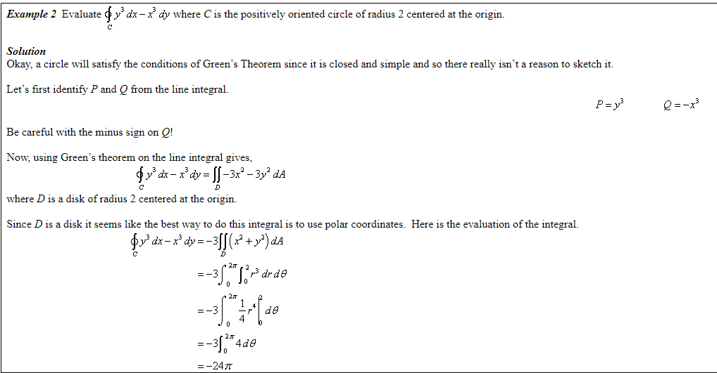

Slide 16
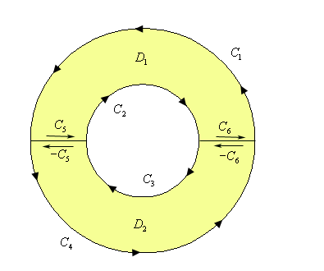
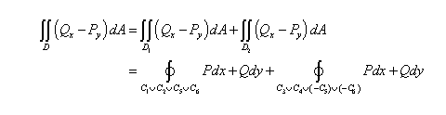
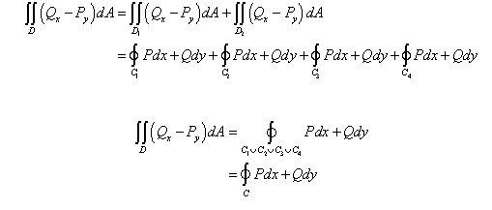
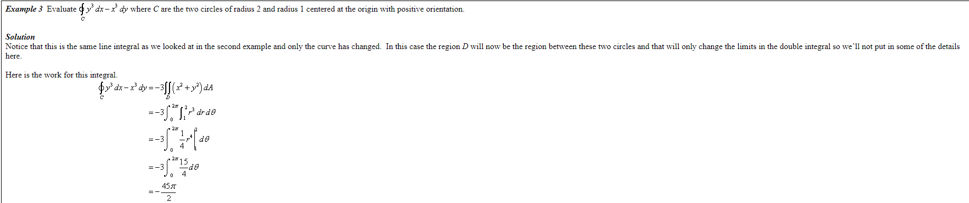
Green’s theorem, as stated, will not work on regions that have holes in them

Slide 17
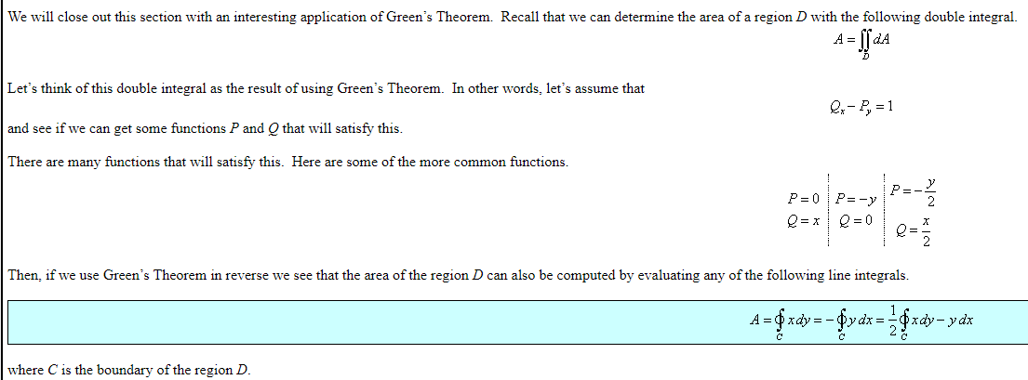
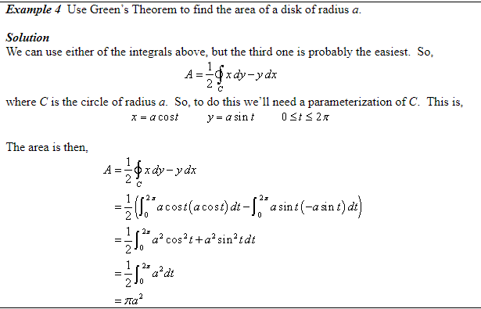
Find the area by Green’s theorem

Slide 18
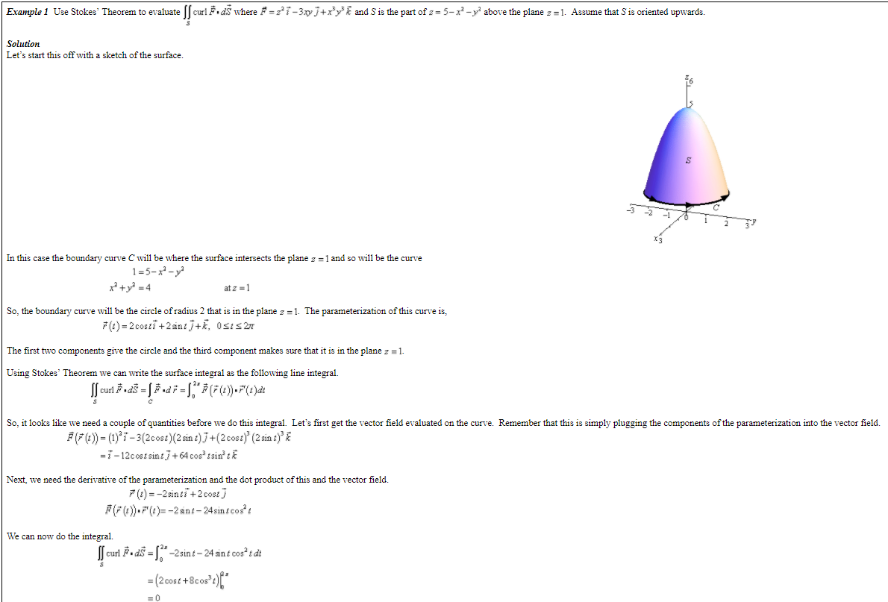
Stokes’ theorem

Slide 19
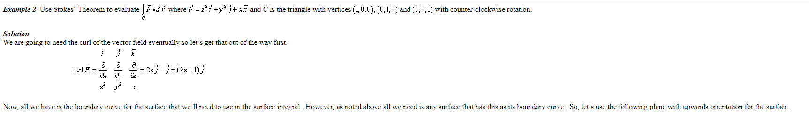
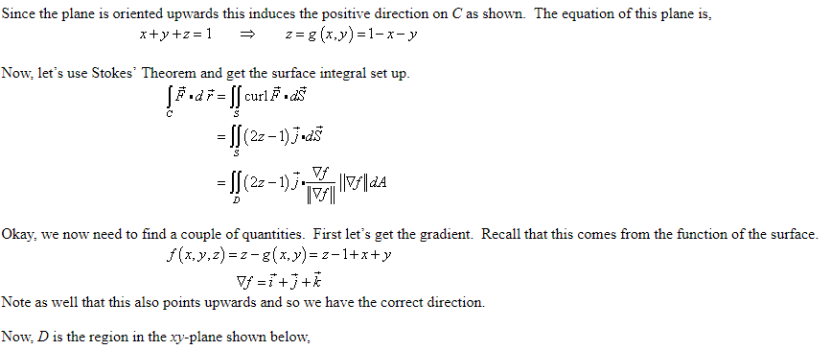
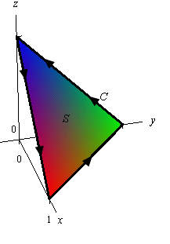
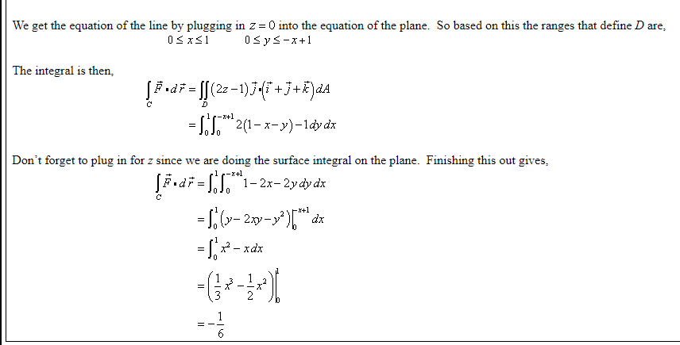
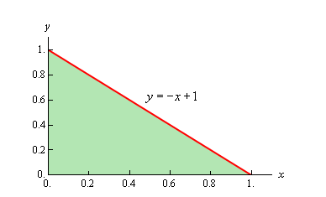

Slide 20
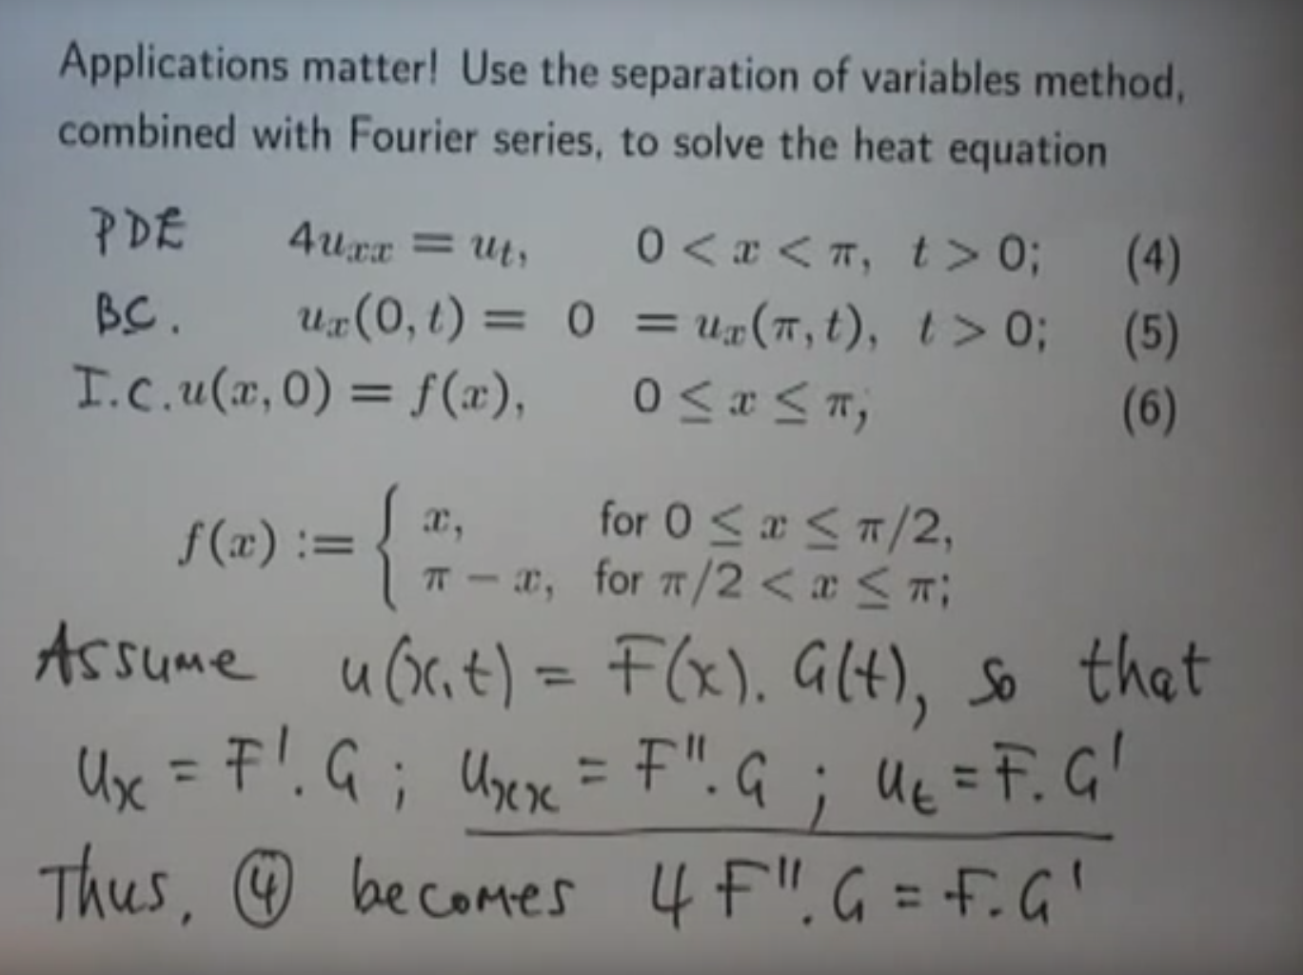
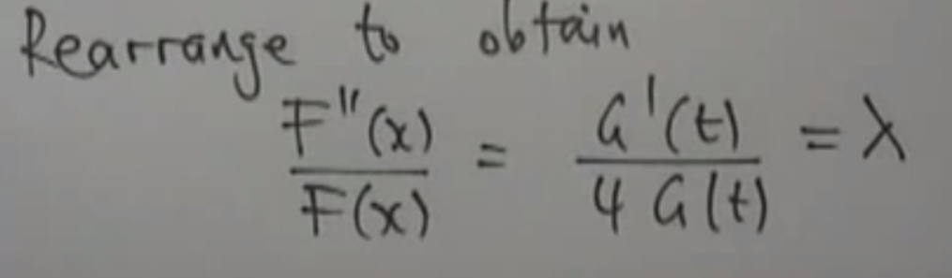
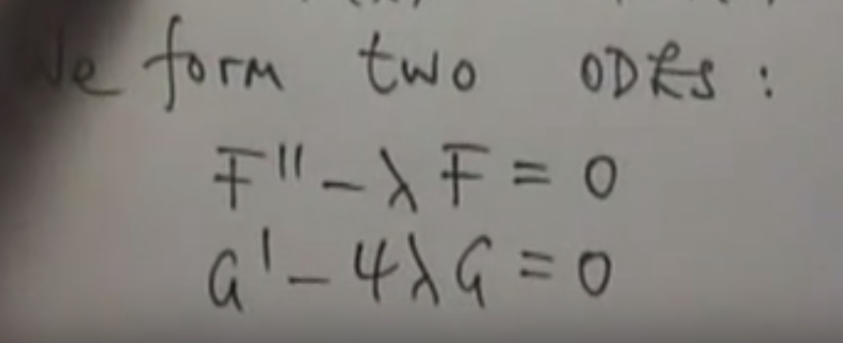
Separation of Variables

Slide 21
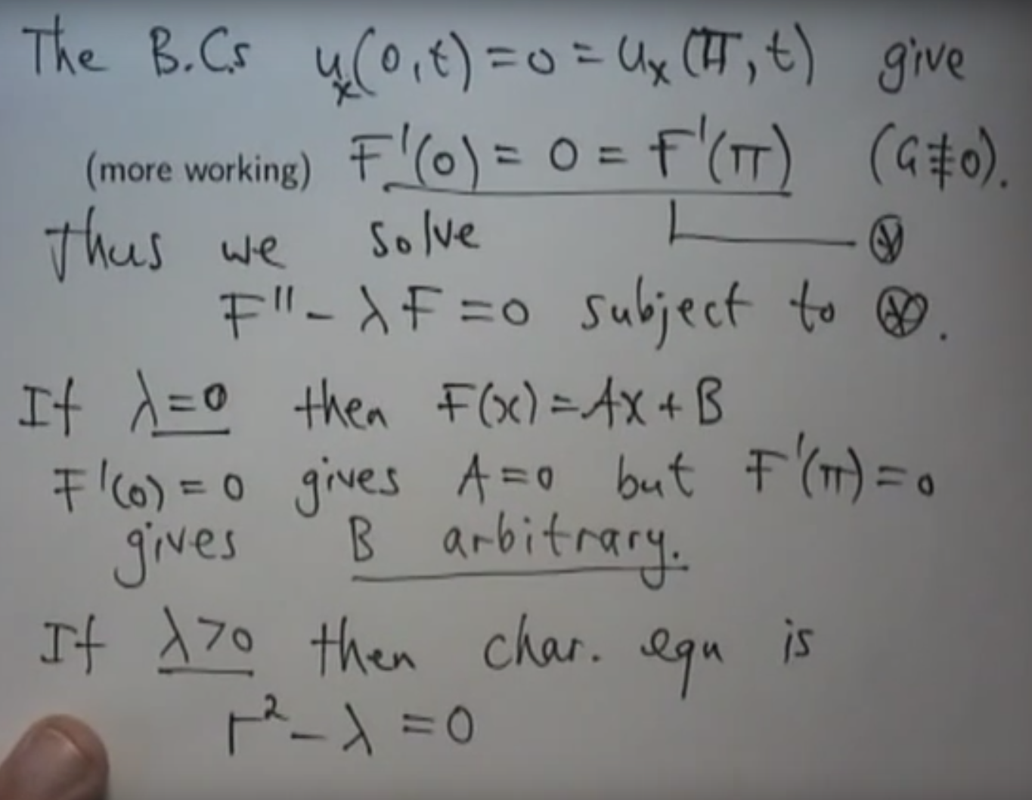
Separation of Variables

Slide 22
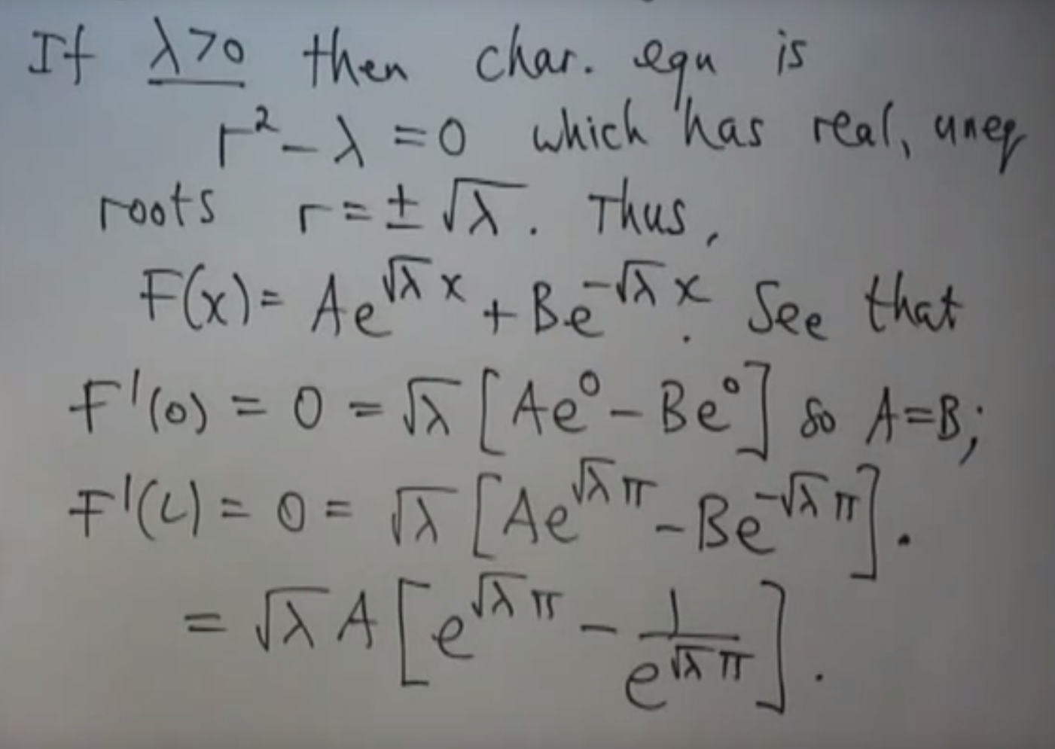
Separation of Variables

Slide 23
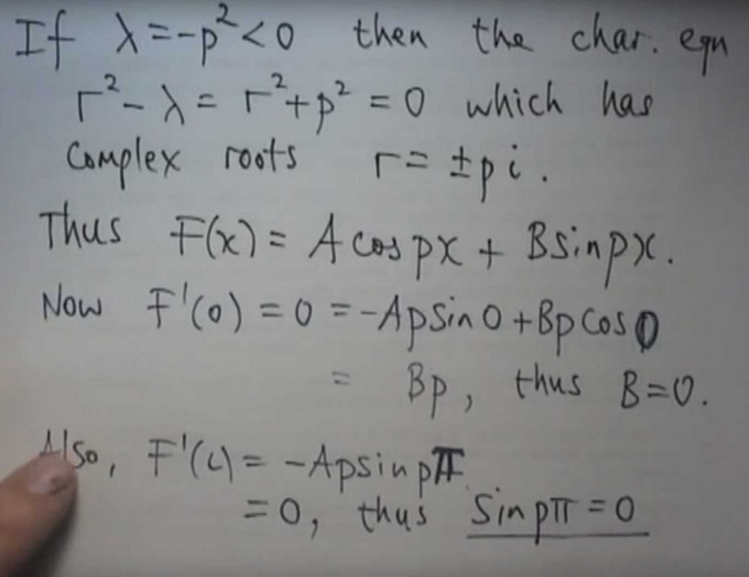
Separation of Variables

Slide 24
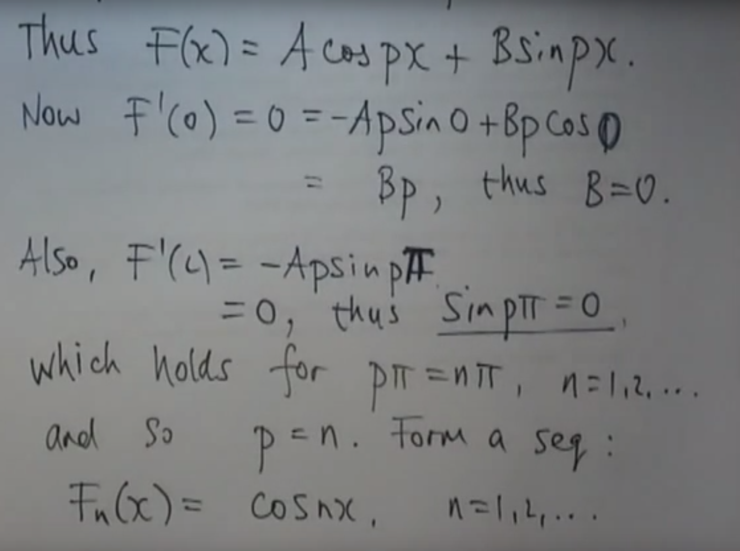
Separation of Variables

Slide 25
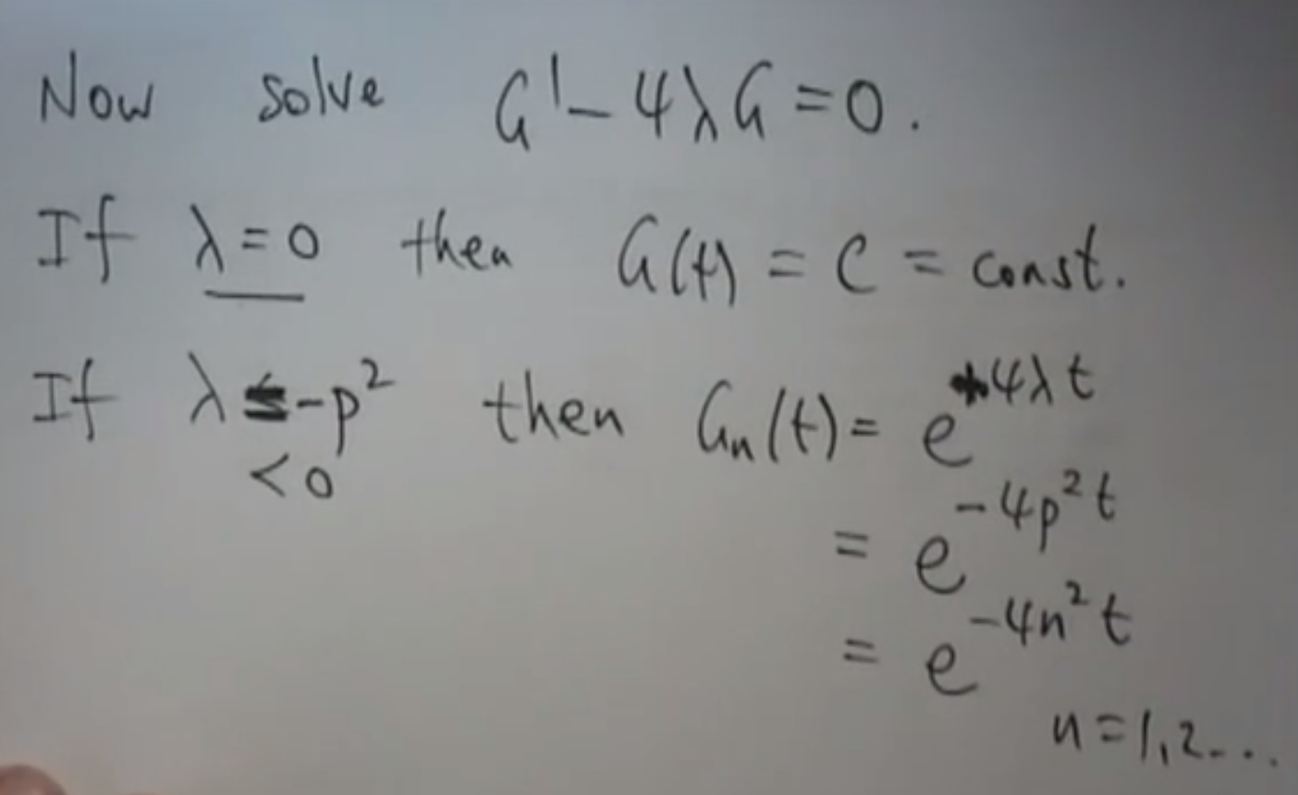
Separation of Variables

Slide 26
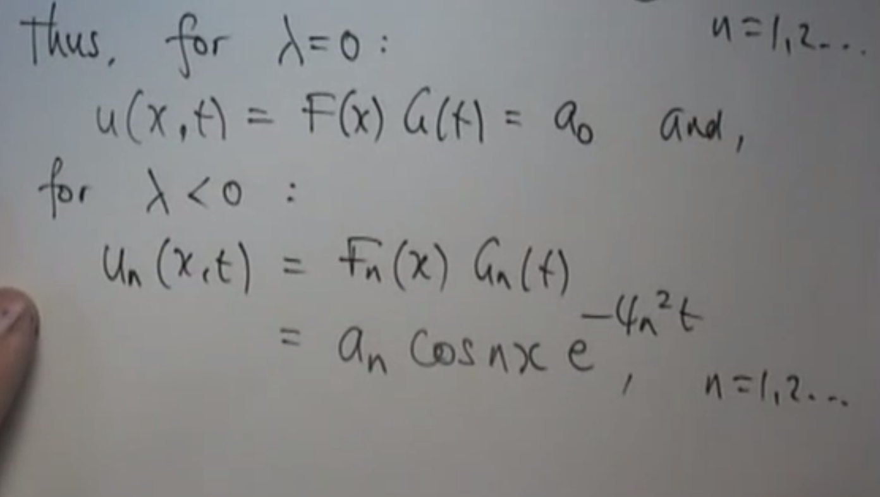
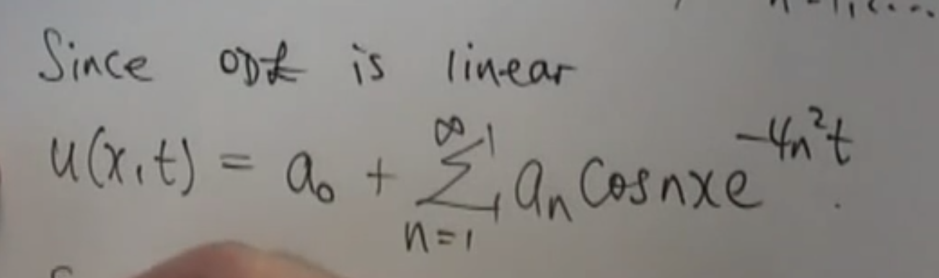
Separation of Variables

Slide 27
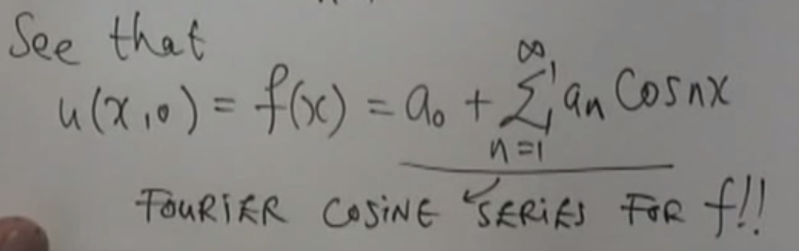
Separation of Variables

Slide 28
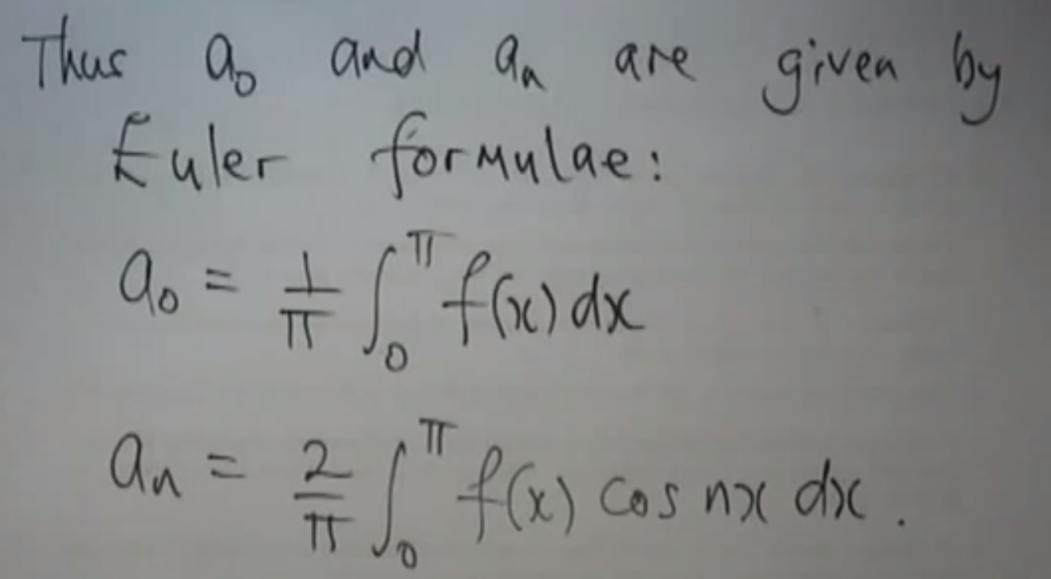
Separation of Variables

Slide 29
Separation of Variables

Slide 30
Separation of Variables

Slide 31
Separation of Variables

Slide 32
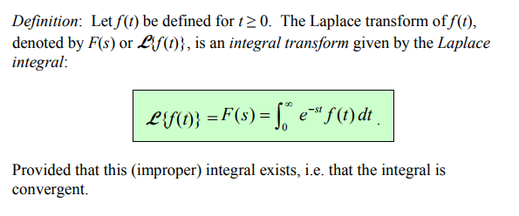
Laplace Transform

Slide 33
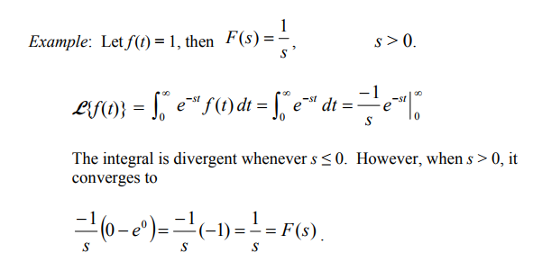
Laplace Transform

Slide 34
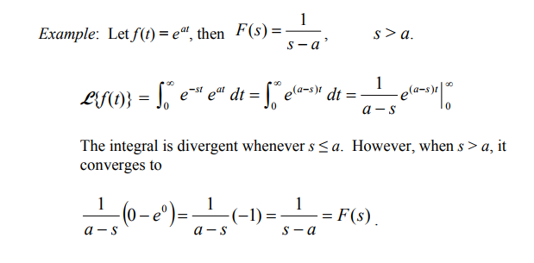
Laplace Transform

Slide 35
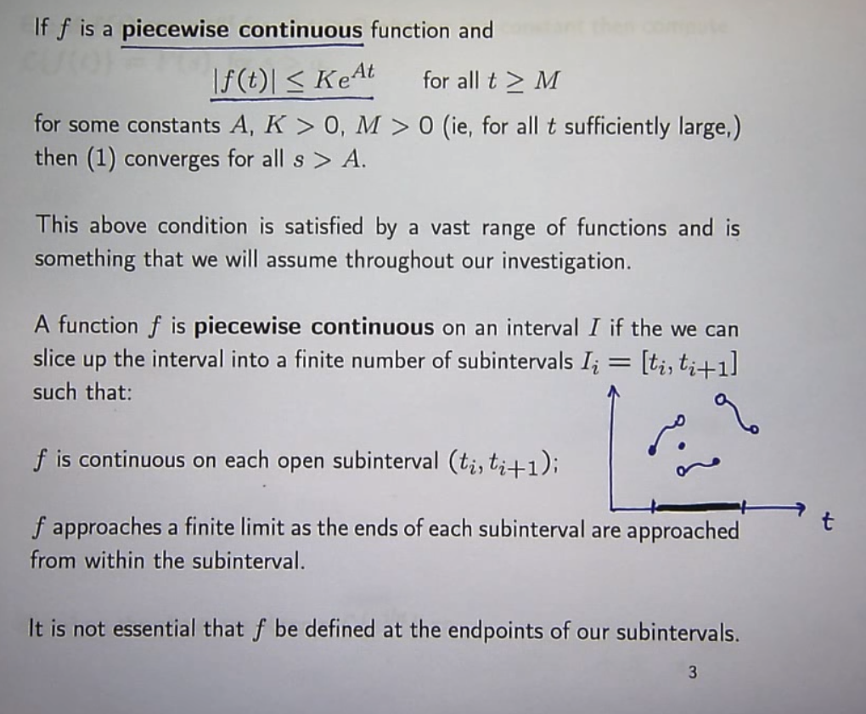
Laplace Transform
f doesn’t go to + or - infinity

Slide 36
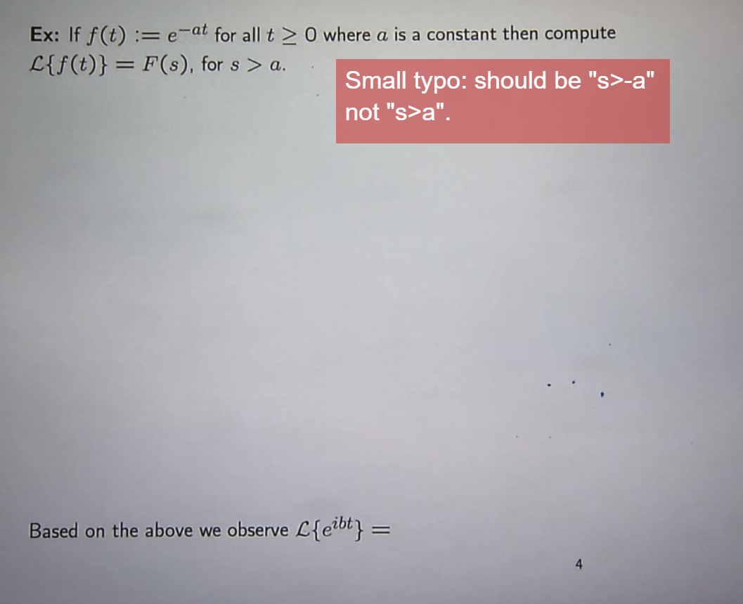
Laplace Transform

Slide 37
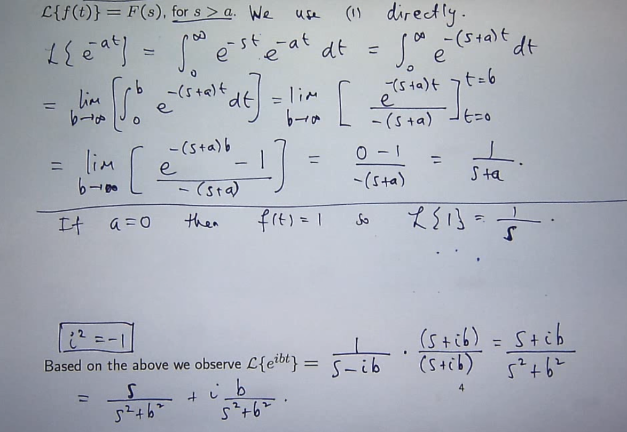
Laplace Transform

Slide 38
Laplace Transform

Slide 39
Laplace Transform

Slide 40
Laplace Transform

Slide 41
Curve Fitting by Least Squares Method
A finite number of points are given. We want to fit a line or a curve that minimizes error
Error is defined as the square of the difference between actual and the fitted curve
We use derivatives to find this minimum.
https://youtu.be/3hz6Tb1i2FY

Slide 42
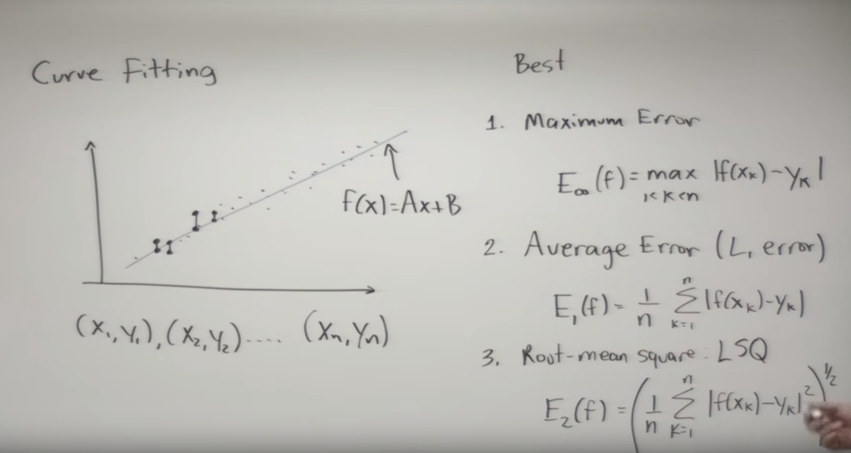
Curve Fitting by Least Squares Method

Slide 43
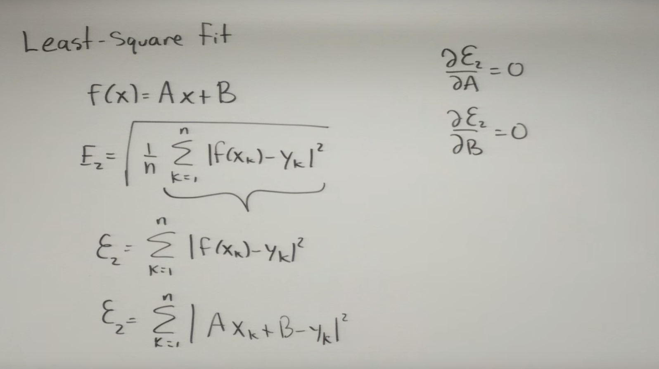
Curve Fitting by Least Squares Method

Slide 44
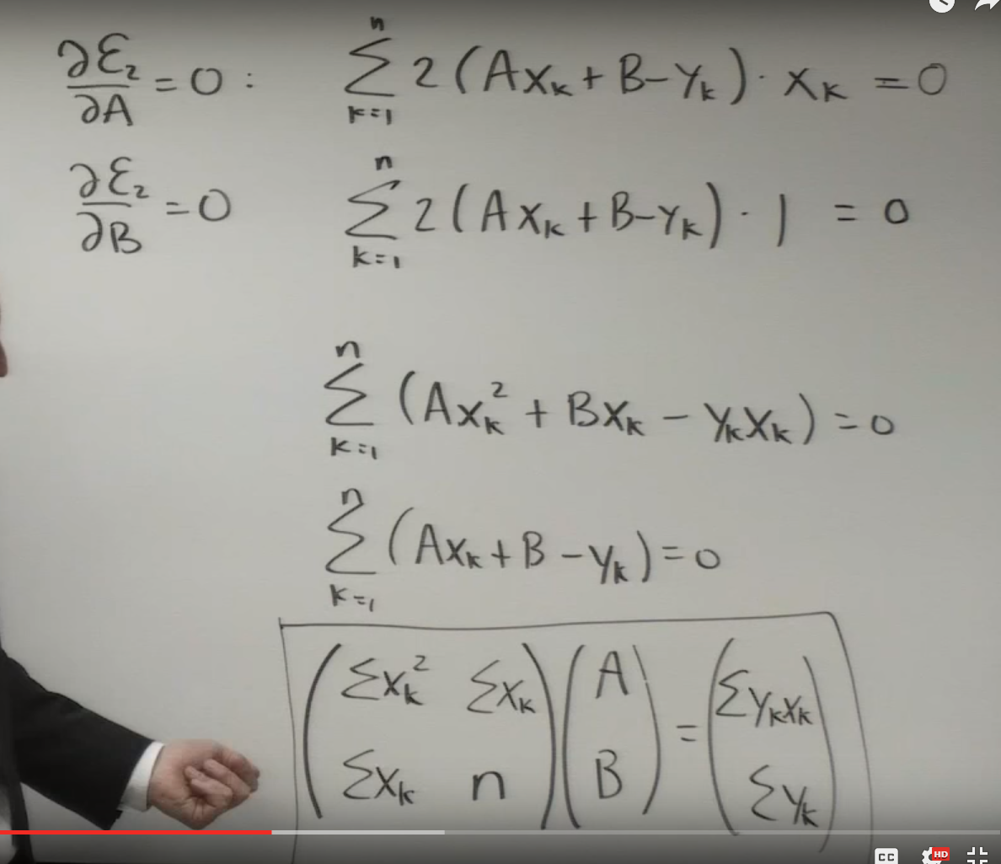
Curve Fitting by Least Squares Method

Slide 45
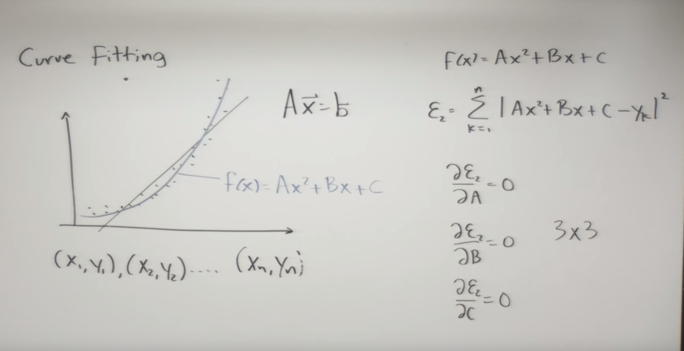
Curve Fitting by Least Squares Method

Slide 46
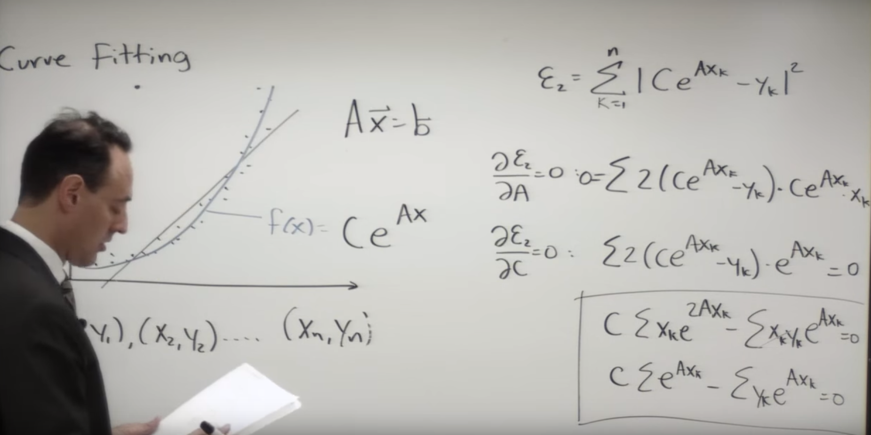
Curve Fitting by Least Squares Method

Slide 47

Curve Fitting by Least Squares Method

Slide 48

Curve Fitting by Least Squares Method

Slide 49
Curve Fitting by Least Squares Method

Slide 50

Ordinary Differential Equation

Slide 51

Ordinary Differential Equation

Slide 52
Ordinary Differential Equation

Slide 53
Ordinary Differential Equation

Slide 54
Ordinary Differential Equation

Slide 55
Ordinary Differential Equation

Slide 56
Ordinary Differential Equation

Slide 57
Ordinary Differential Equation

Slide 58
Ordinary Differential Equation

Slide 59
Ordinary Differential Equation

